Slide 1

Technical Test
Drug Repurposing
Zahra Zabihinpour
Feb. 2024

Slide 2
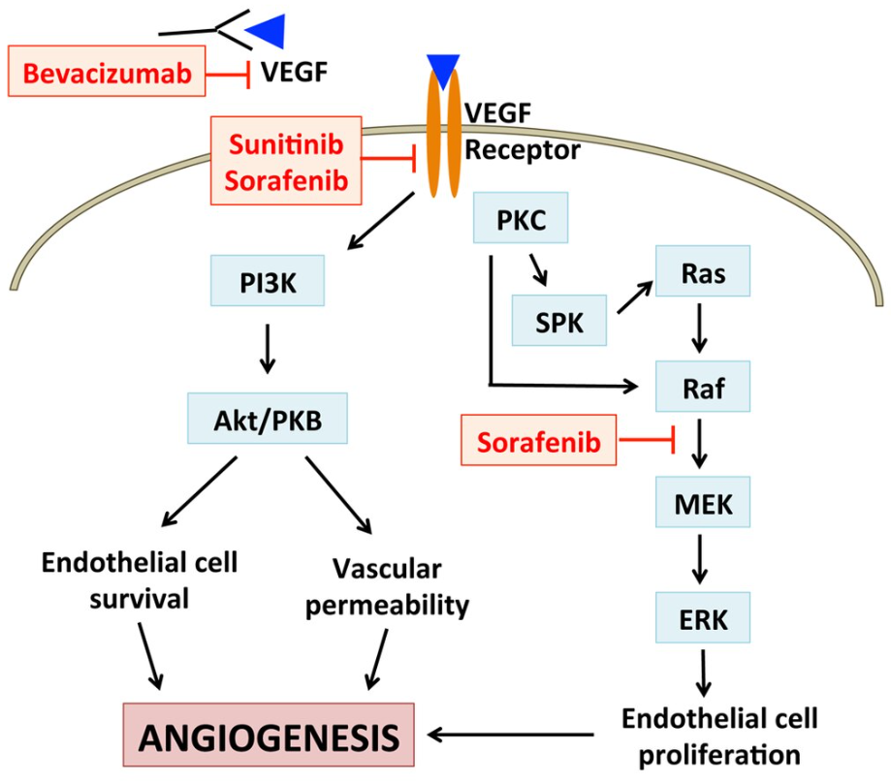
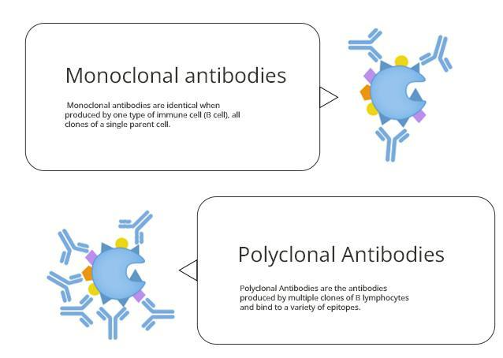
Bevacizumab
Bevacizumab is a recombinant humanized monoclonal antibody that blocks angiogenesis by inhibiting vascular endothelial growth factor A (VEGF-A).
VEGF-A is a growth factor protein that stimulates angiogenesis in a variety of diseases, especially in cancer.
https://en.wikipedia.org/wiki/Bevacizumab

Slide 3
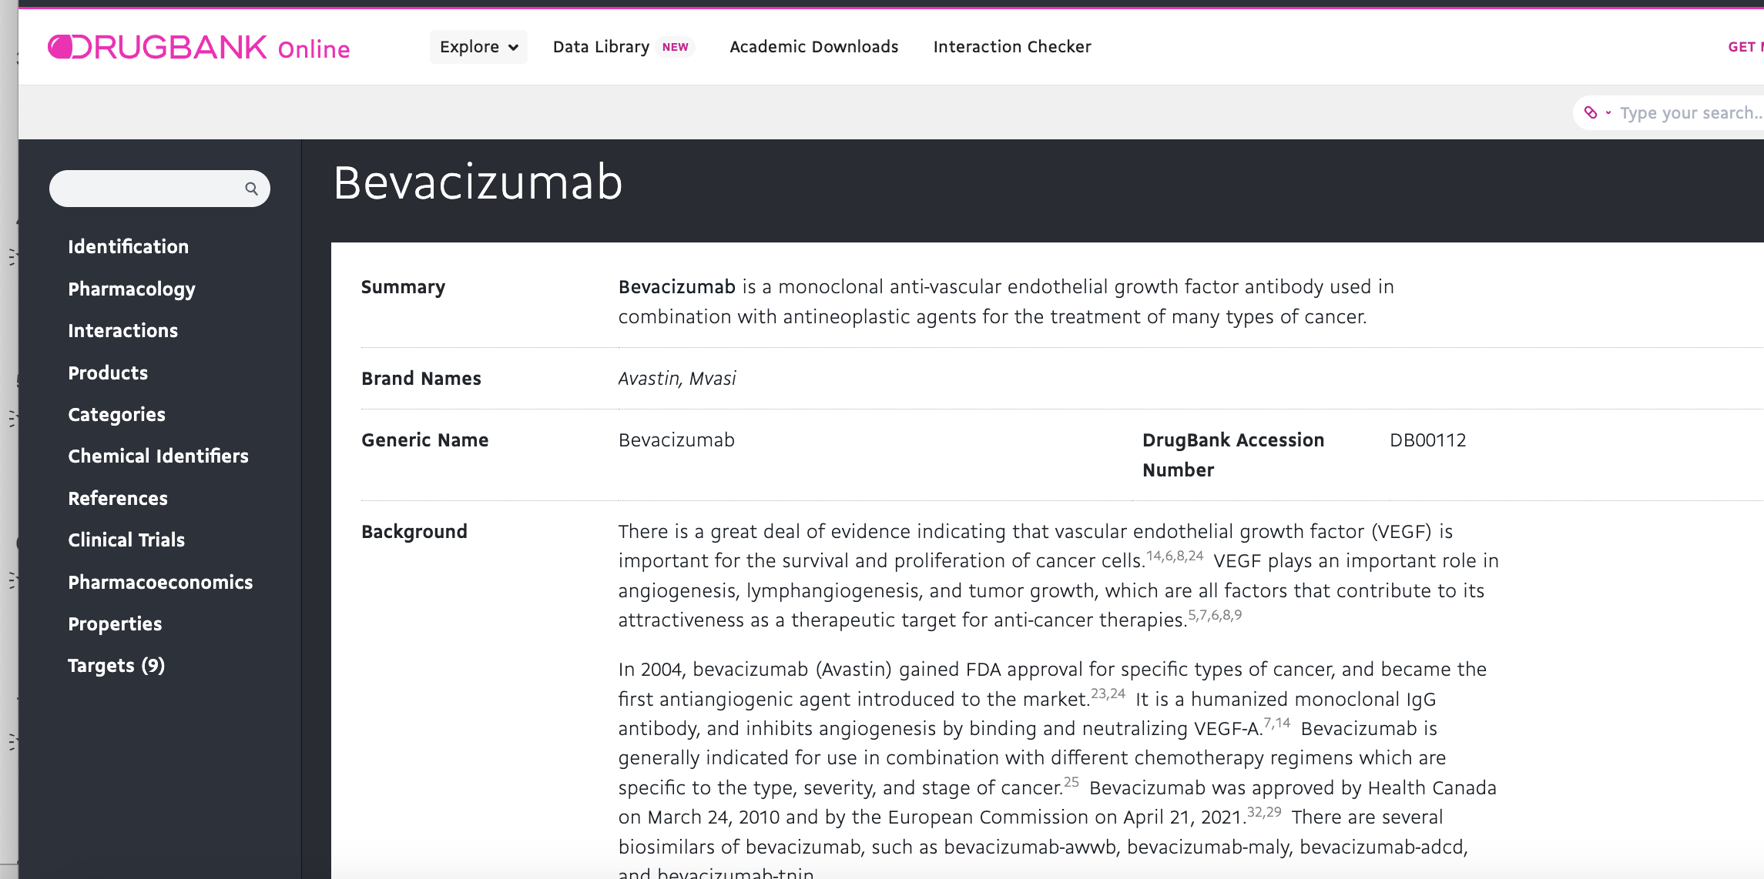
Exploring DRUGBANK
https://go.drugbank.com/

Slide 4
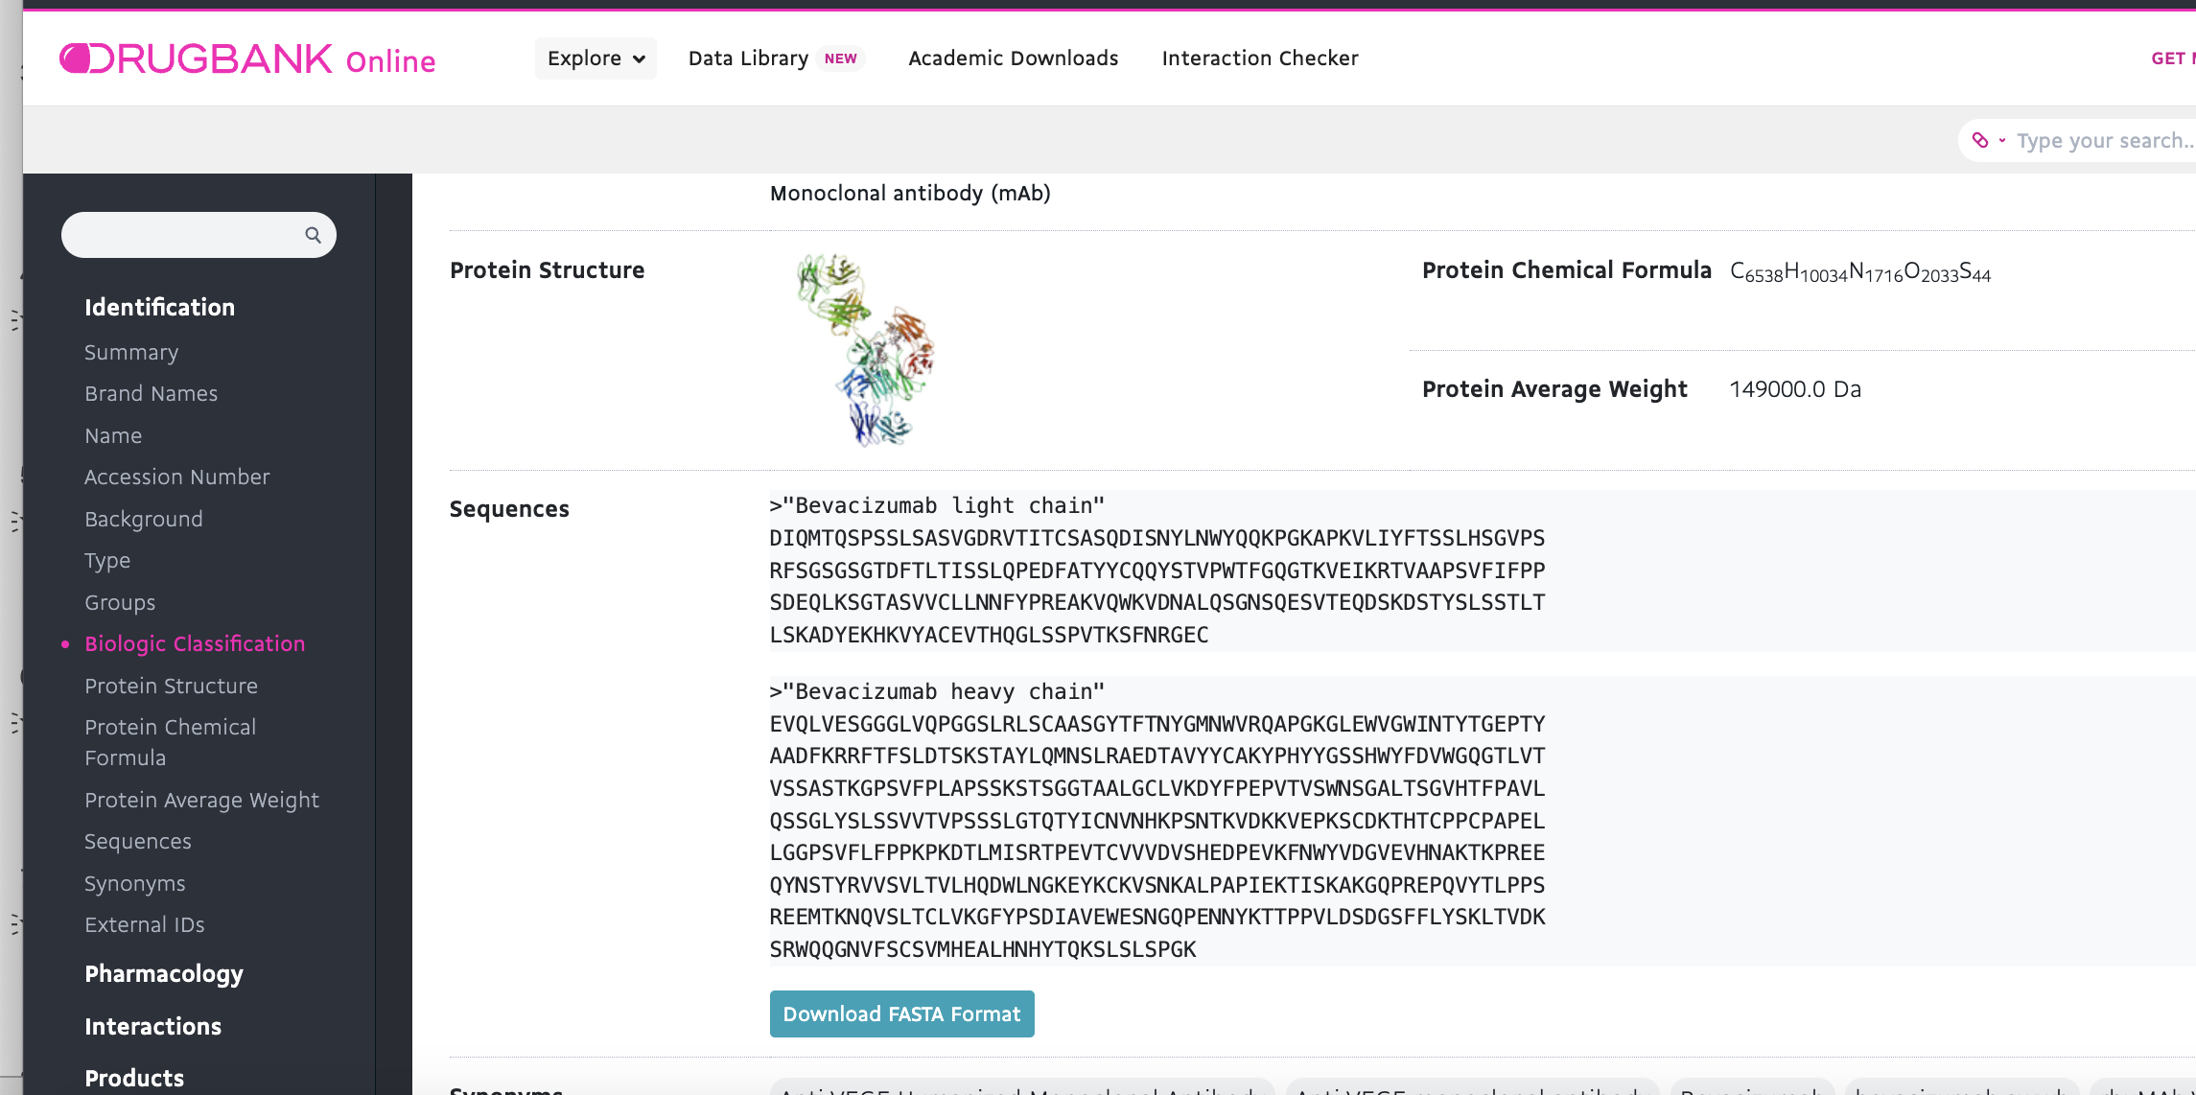
DRUGBANK
https://go.drugbank.com/

Slide 5
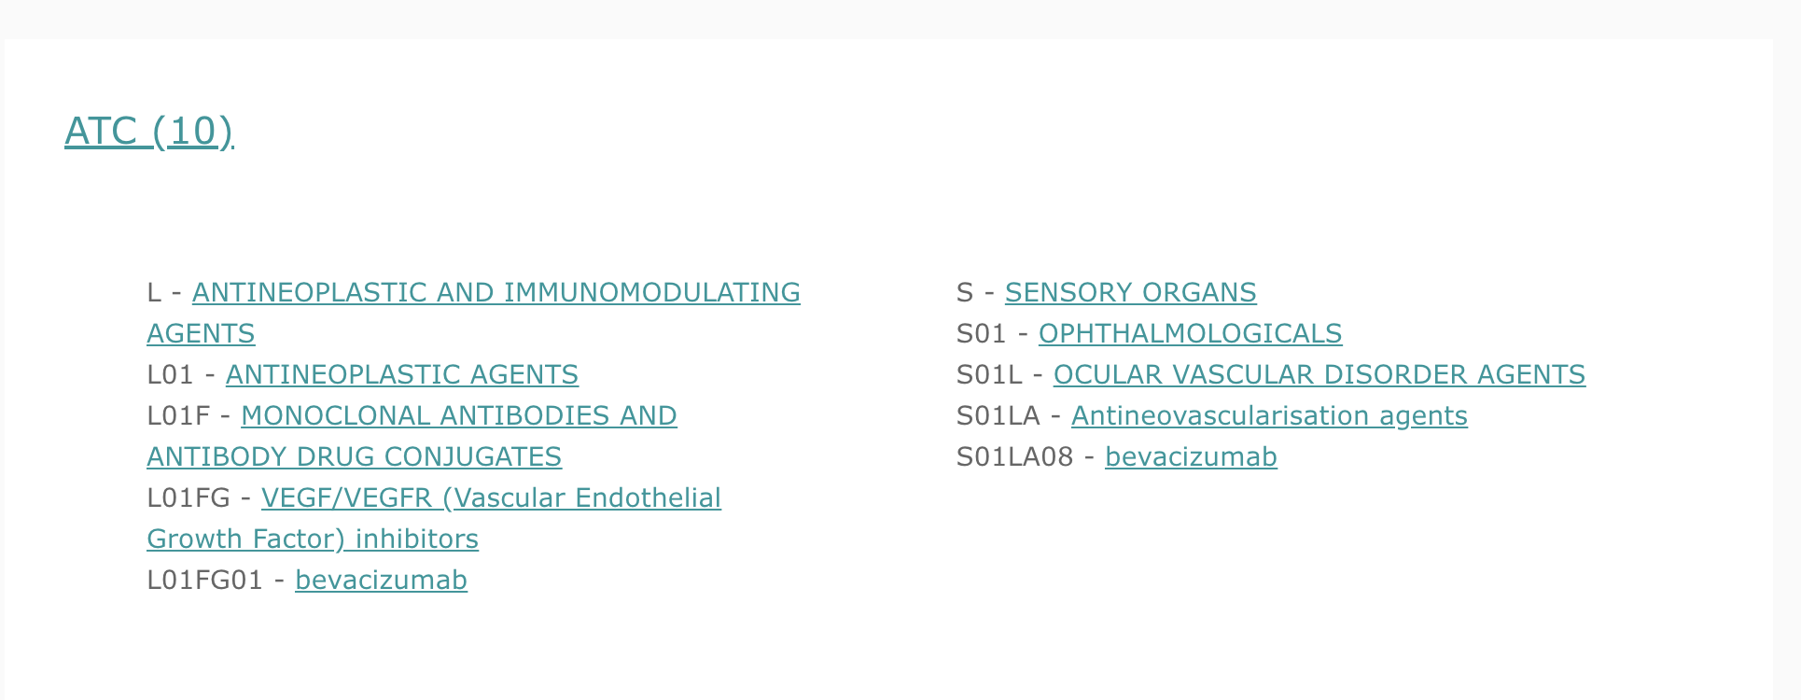
DRUGBANK
https://go.drugbank.com/

Slide 6
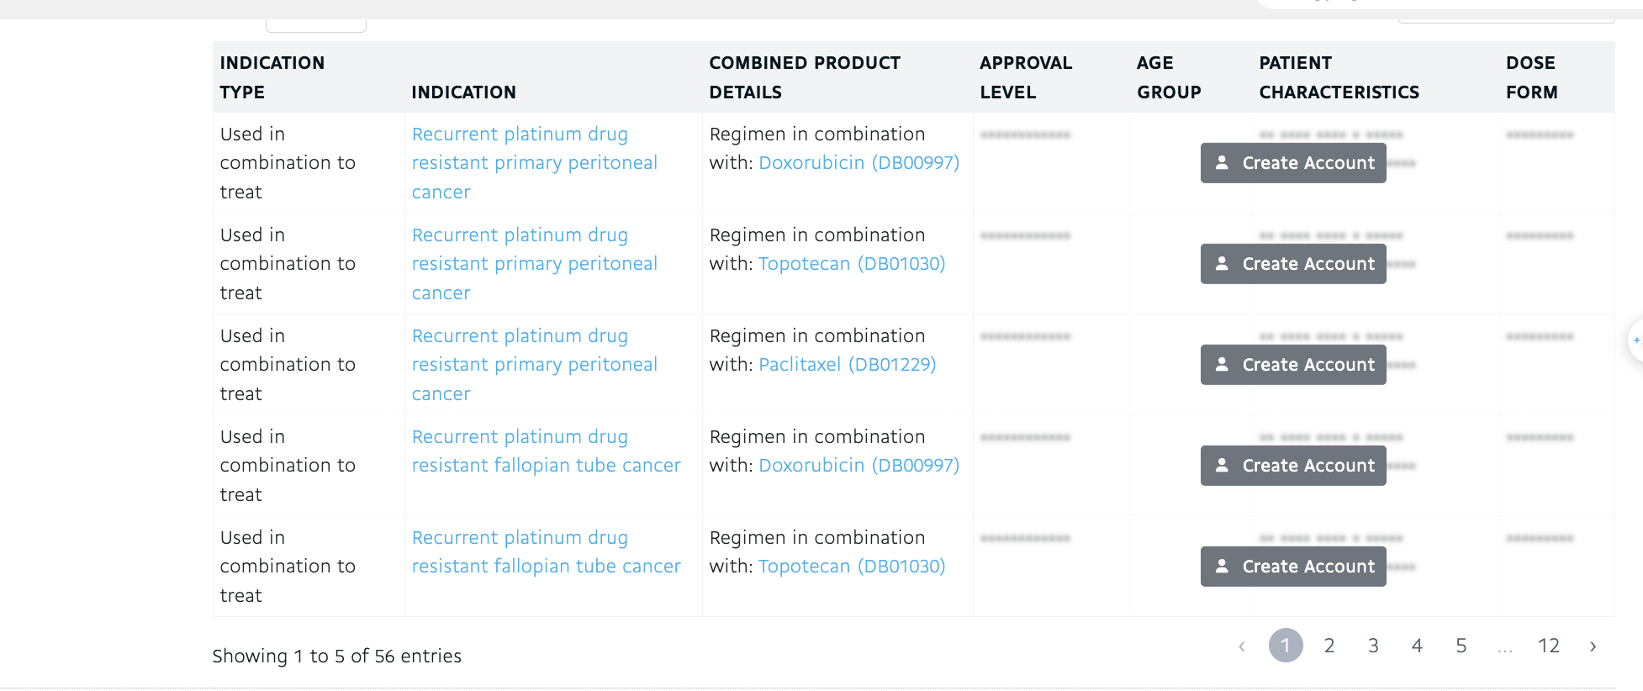
DRUGBANK
If we had access to database, we could make a list of indications
But it is not allowed in drugbank without login to an confirmed account.
https://go.drugbank.com/

Slide 7
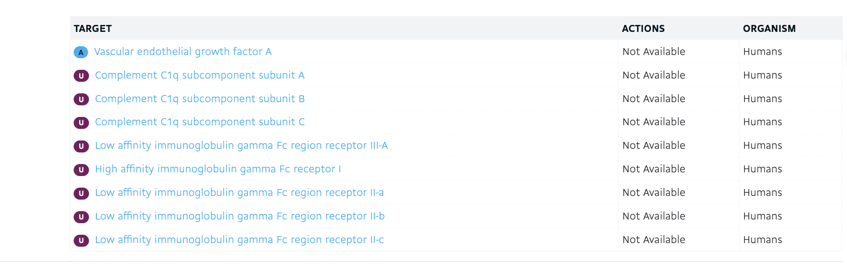
DRUGBANK
https://go.drugbank.com/

Slide 8
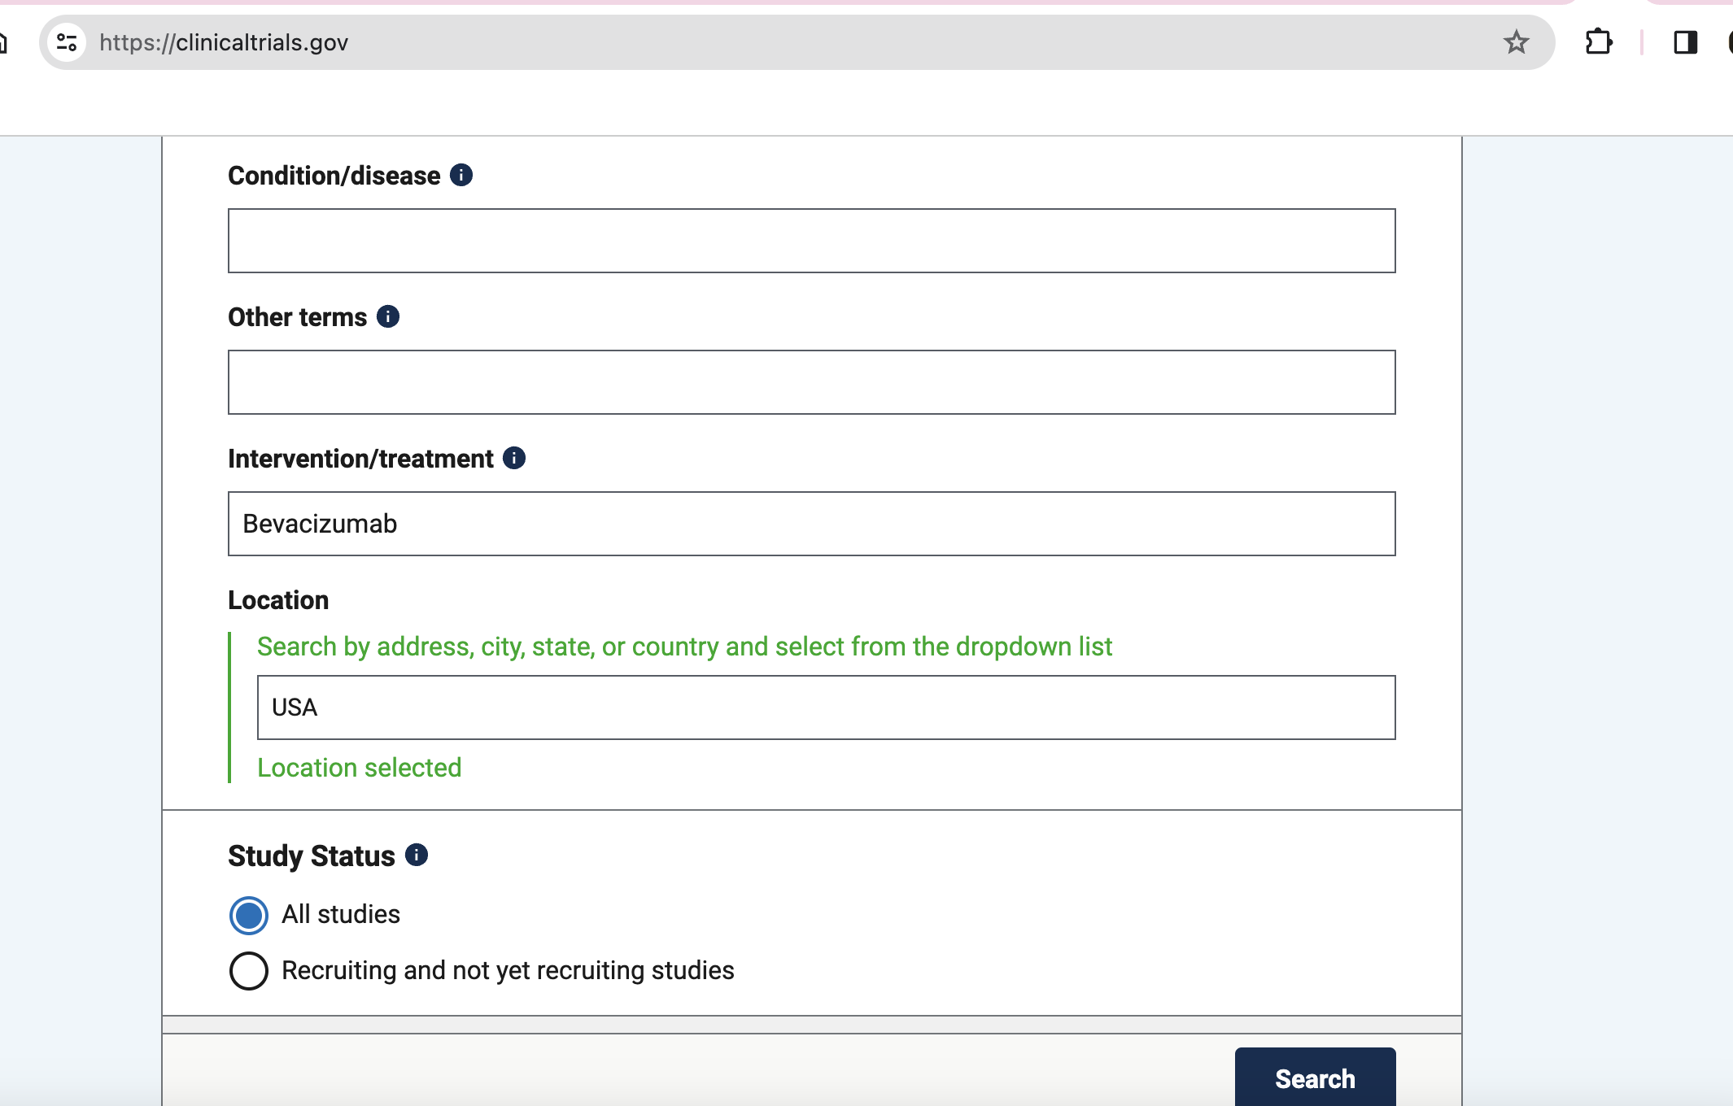
clinicaltrials.gov

Slide 9
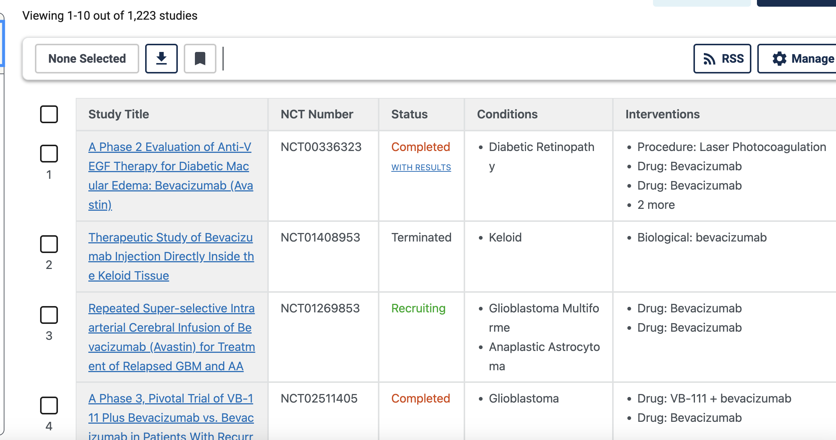
clinicaltrials.gov

Slide 10
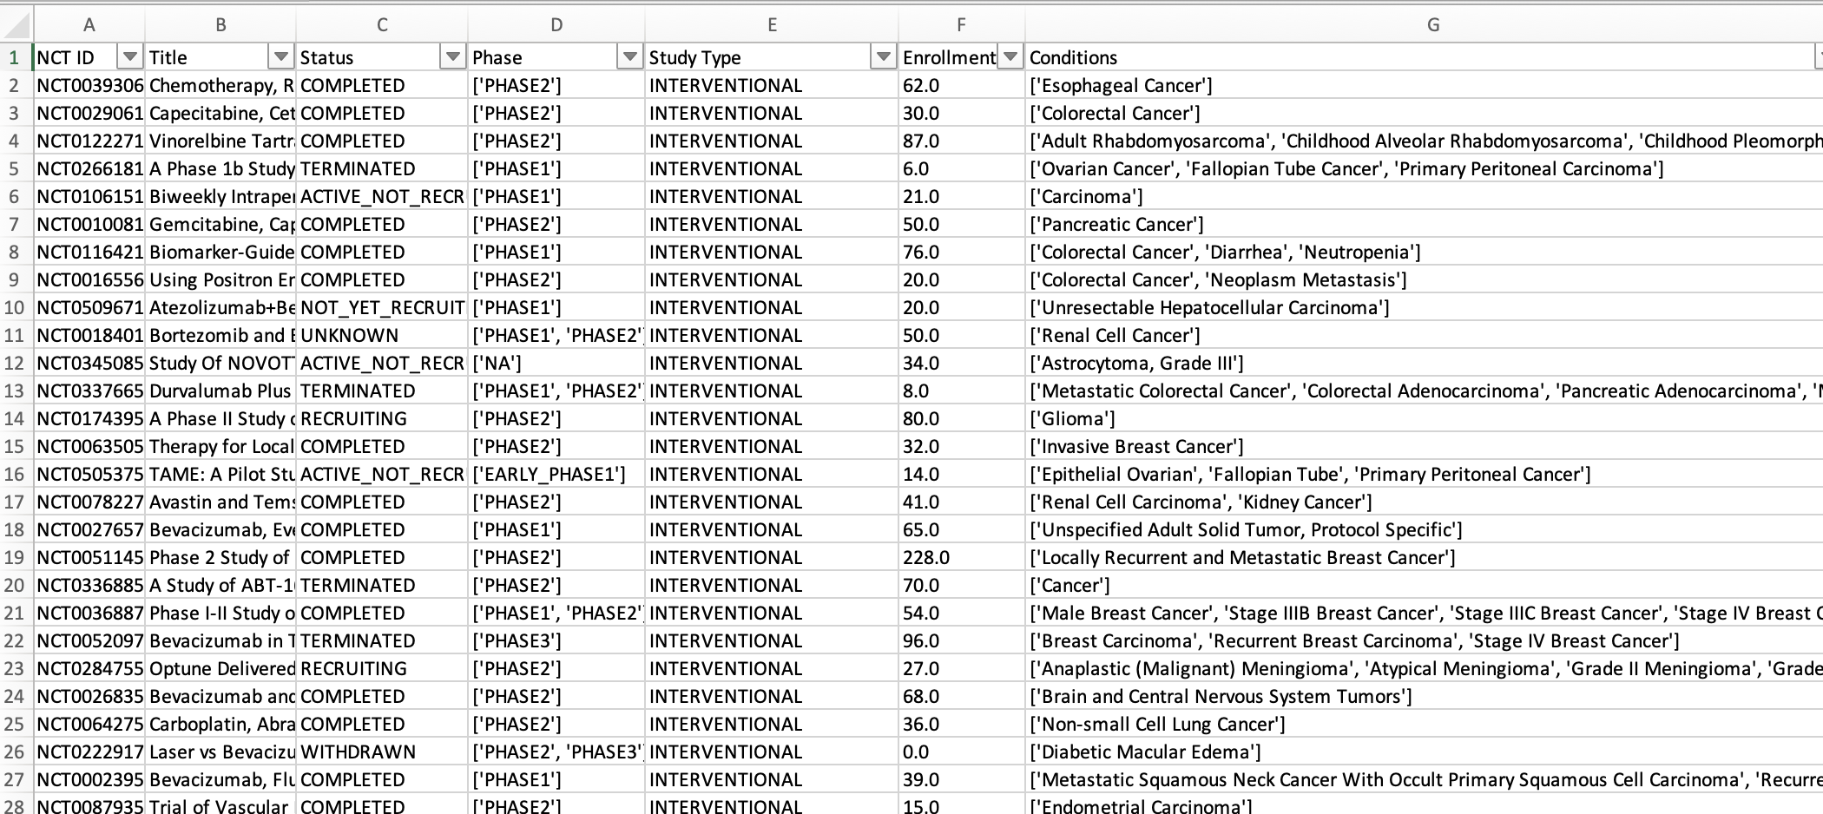
Data Extraction for Bevacizumab Studies
Source of Data: ClinicalTrials.gov
Objective: To extract comprehensive data on Bevacizumab studies in the USA
Data Points Extracted:
NCT ID (National Clinical Trial ID)
Title of the Study
Status (e.g., Active, Completed, Terminated)
Phase (I, II, III, or IV)
Study Type (e.g., Interventional, Observational)
Enrollment Numbers
Conditions Treated
Method Used: Web scraping
Outcome: Dataset
You can find the codes and csv file here:
https://github.com/zabihin/ODDIF/tree/main/clinicaltrial`

Slide 11
Bevacizumab Studies Overview in the USA
Database Searched: ClinicalTrials.gov
Total Studies on Bevacizumab: 1,223
Criteria for Inclusion:
Enrollment > 3
Status: COMPLETED or TERMINATED
Studies Meeting Criteria: 891
Disease Conditions Analysed:
Total Names: 2,324
Unique Diseases: 1,000
You can find the codes and csv file here:
https://github.com/zabihin/ODDIF/tree/main/clinicaltrial`

Slide 12
Identifying Rare Diseases in the USA
Next Step: To identify which diseases are classified as rare in the USA.
Approach:
Utilize a reliable database for rare diseases.
Cross-reference the diseases found in Bevacizumab studies.
Data Source: National Organization for Rare Disorders (NORD) at rarediseases.org
Expected Outcome:
A list of rare diseases from Bevacizumab studies.
Better understanding of Bevacizumab's impact on rare conditions.

Slide 13
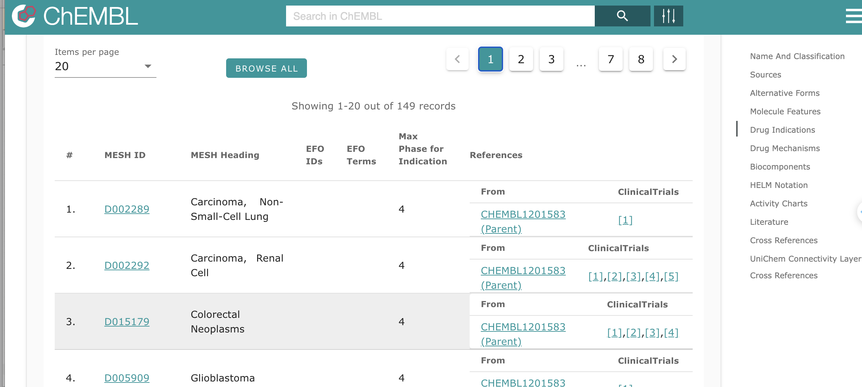
Other source: Exploring ChEMBL
149 Disease
Other info: phase
Link to clinical trial
https://www.ebi.ac.uk/chembl/

Slide 14
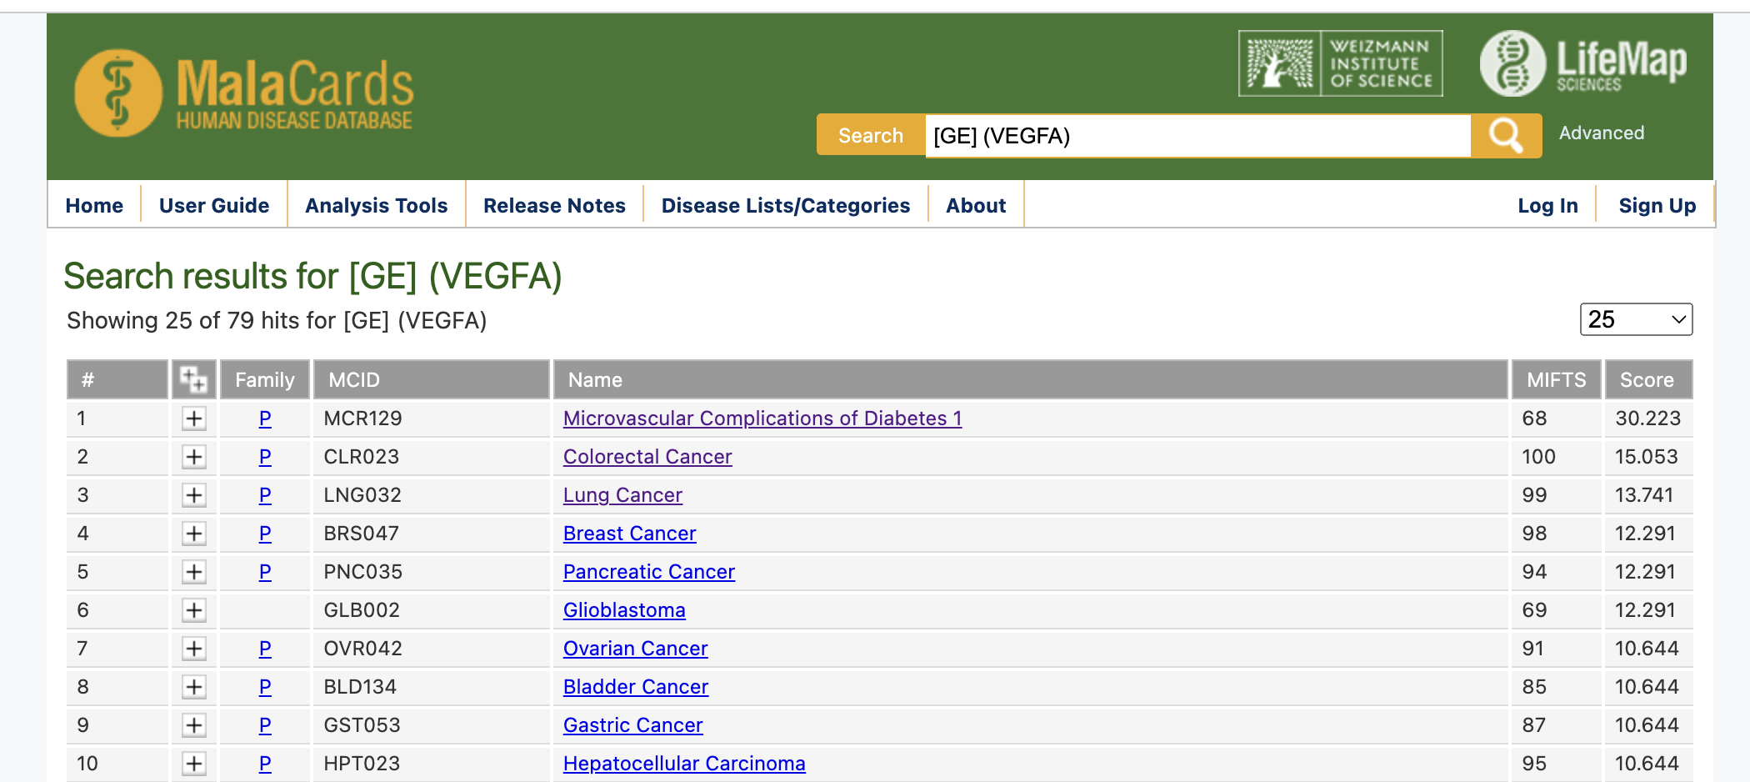
Identifying Disease Indications Linked to VEGFA Gene
VEGFA Gene Association Search
Searched for diseases linked to the VEGFA gene, the target of Bevacizumab.
Results: Found 79 disease indications related to the VEGFA gene.
https://www.malacards.org

Slide 15
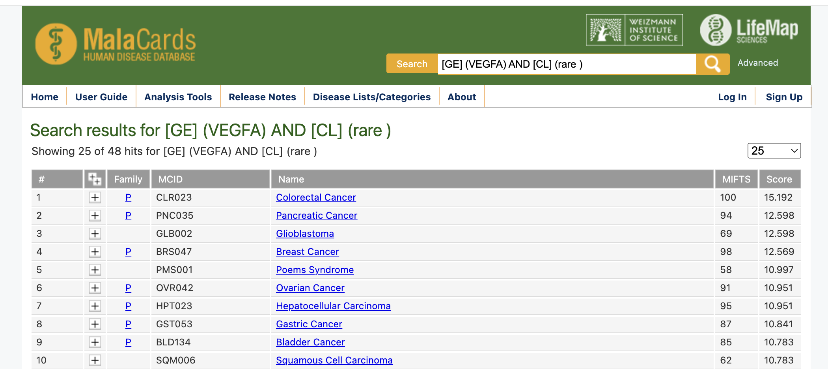
Narrowing Down to Rare Diseases Associated with VEGFA
Inclusion of Rare Disease
Conducted a refined search combining “VEGFA” as a gene with “Rare disease” as a classification.
Results: Identified 48 indications related to VEGFA gene classified as rare diseases.
https://www.malacards.org

Slide 16
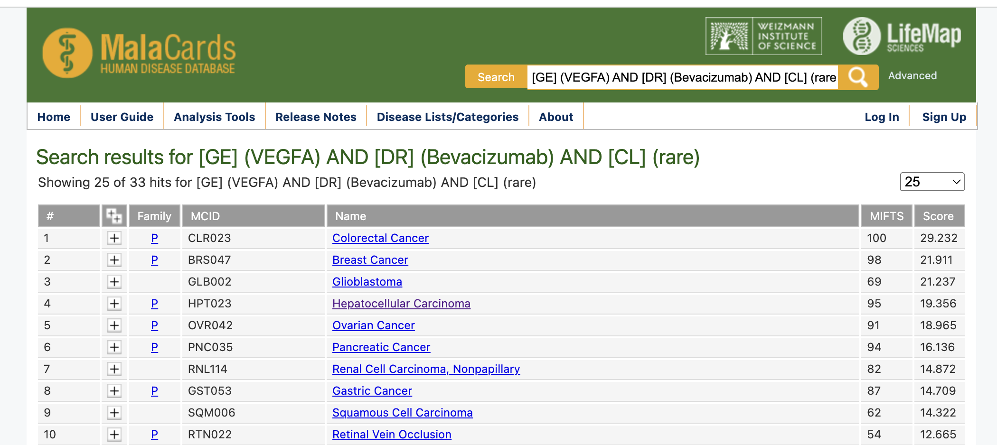
Bevacizumab Treatment Correlation
Cross-Referencing with Bevacizumab Treatment
Further refined the search to include “Bevacizumab” as a drug in the context of VEGFA-related rare diseases.
Results: Discovered 33 rare disease indications treated by Bevacizumab, related to the VEGFA gene.
https://www.malacards.org

Slide 17
Potential Candidates for Bevacizumab Treatment
Out of the 48 rare diseases associated with the VEGFA gene, 33 are currently treated with Bevacizumab.
Key Finding: There are 15 rare diseases associated with the VEGFA gene that are not currently treated with Bevacizumab and may be potential candidates for therapy.
Poems Syndrome
Ovarian Hyperstimulaton Syndrome
Pre-Eclampsia
Sudden Infant Death Syndrome
Pseudoxanthoma Elasticum
Sickle Cell Disease
Fabry Disease
Antiphopholipid Syndrome
Severe Combined Immunodeficiency
Tetralogy of Fallot
Hemifacial Spasm
Polycystic Kidney Disease
Viral Encephalitis
Psoriatic Arthritis
Pyogenic Granuloma
https://www.malacards.org

Slide 18
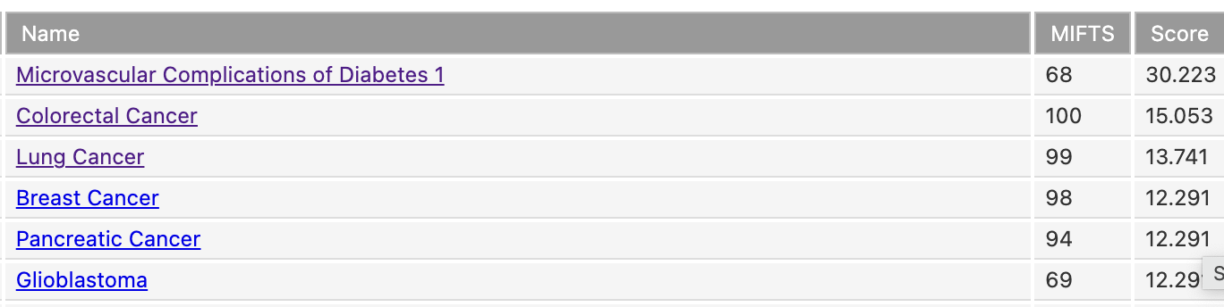
VEGFA Gene and Related Diseases

Slide 19
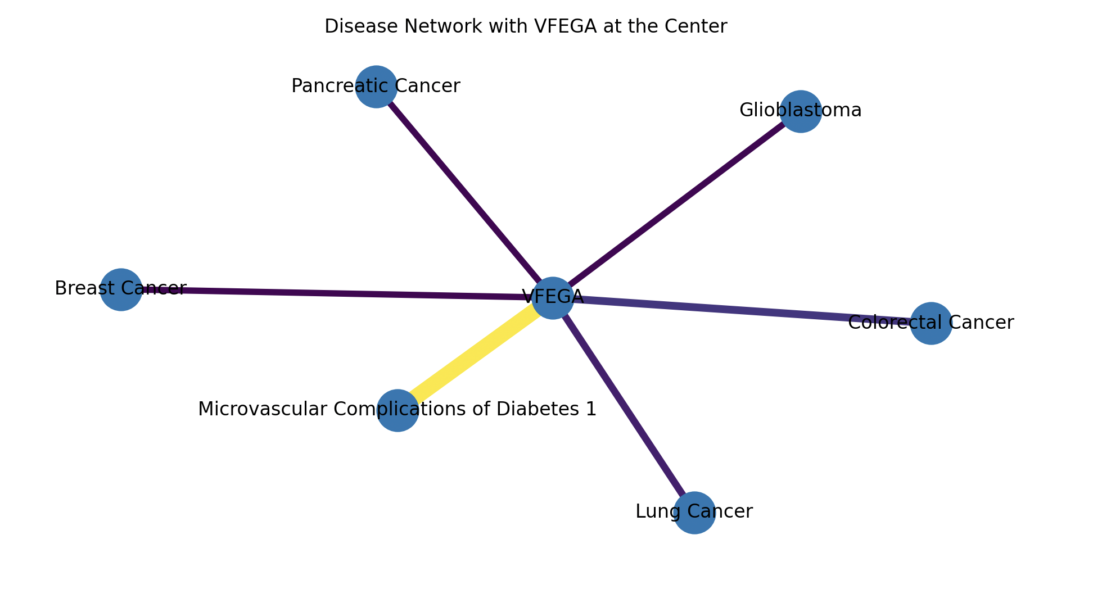
VFEGA-Diseases

Slide 20
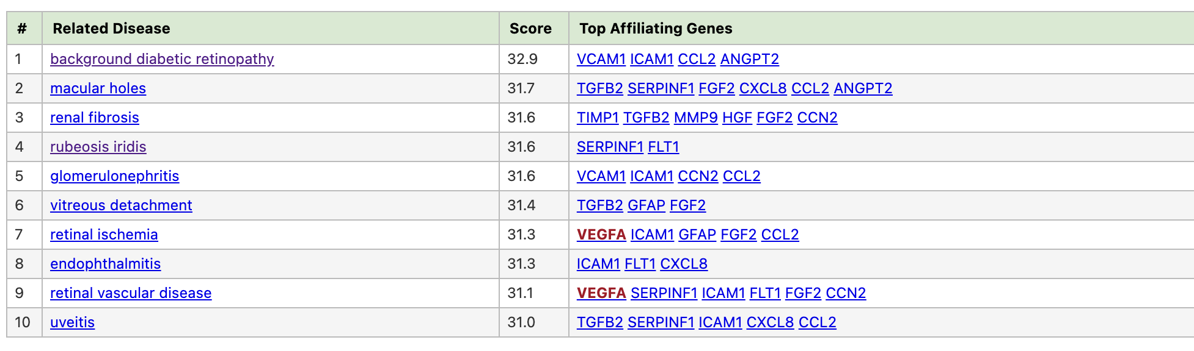
Microvascular Complications of Diabetes 1

Slide 21
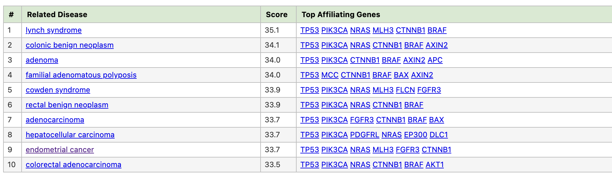
Colorectal Cancer (CRC)

Slide 22
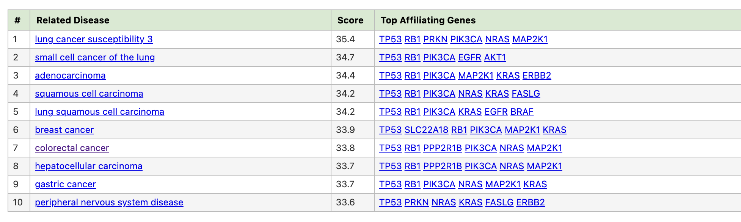
Lung Cancer (LNCR)

Slide 23
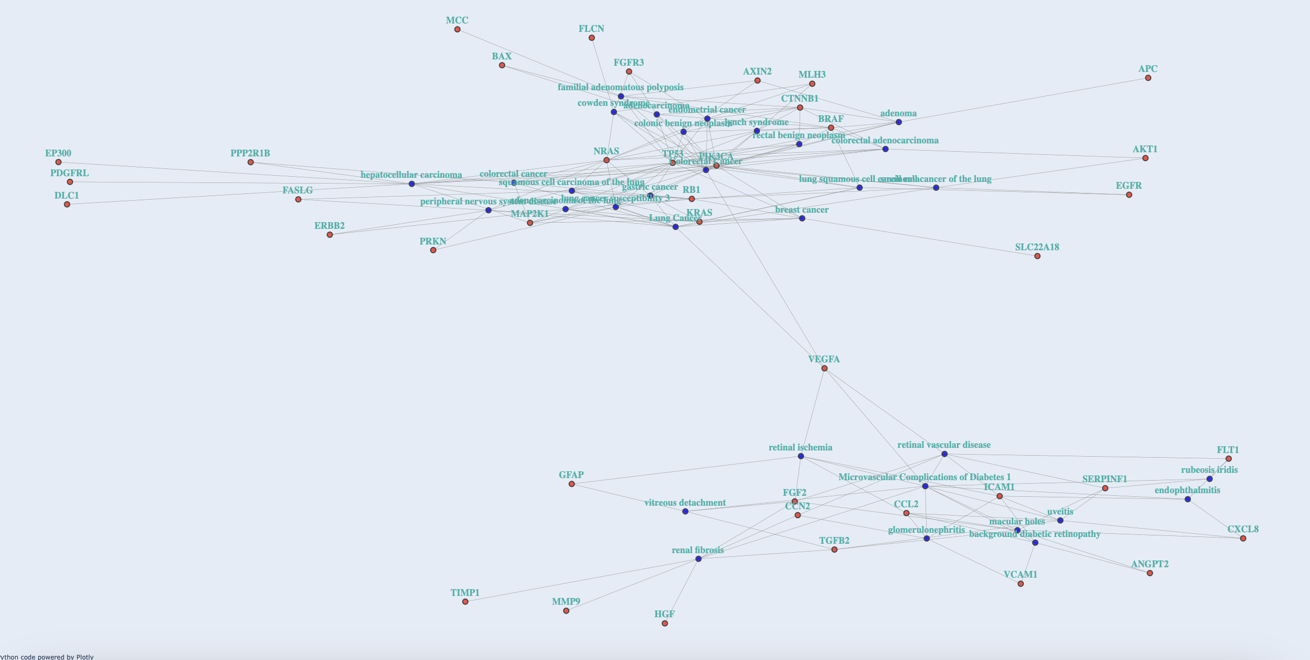

Slide 24
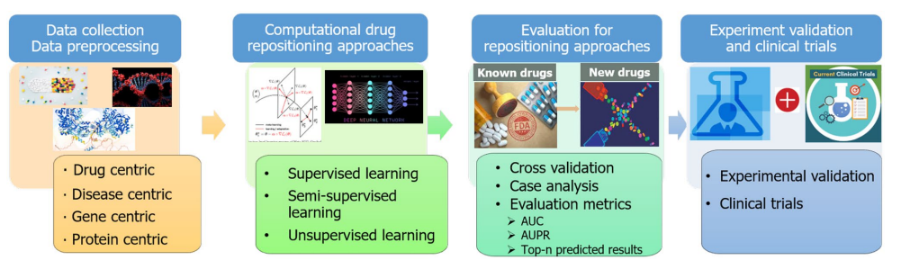
Drug Repurposing and Machine Learning
https://www.ncbi.nlm.nih.gov/pmc/articles/PMC6097480/

Slide 25
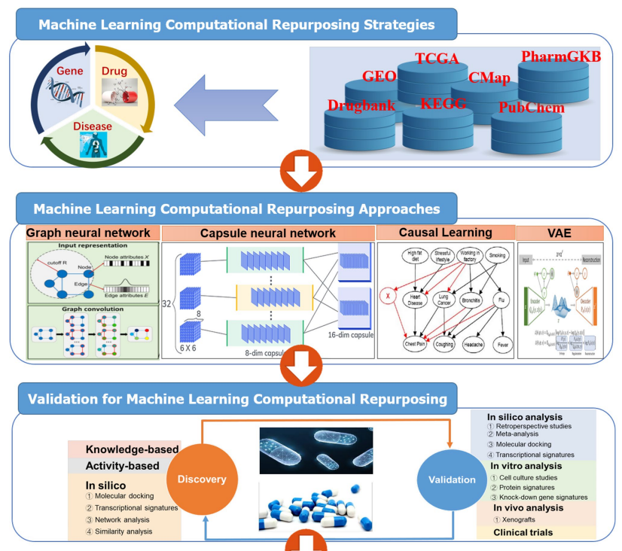
Drug Repurposing and Machine Learning
https://www.ncbi.nlm.nih.gov/pmc/articles/PMC6097480/

Slide 26
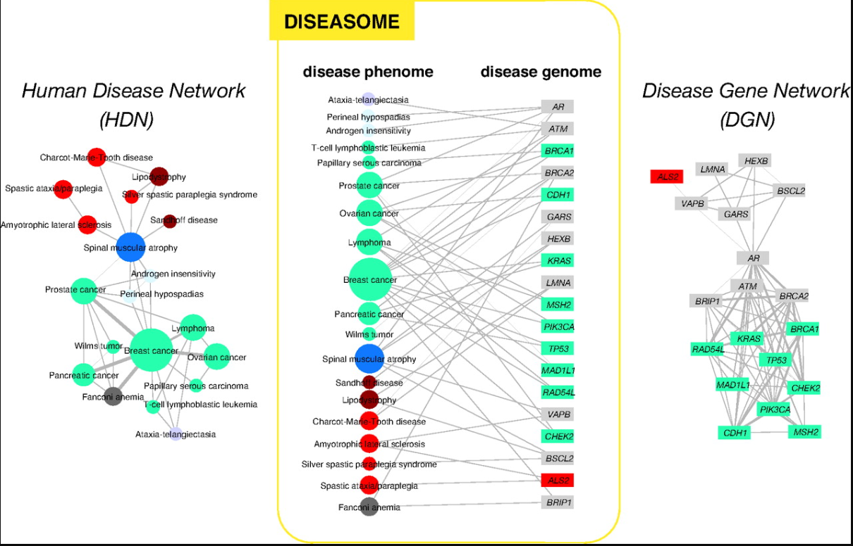
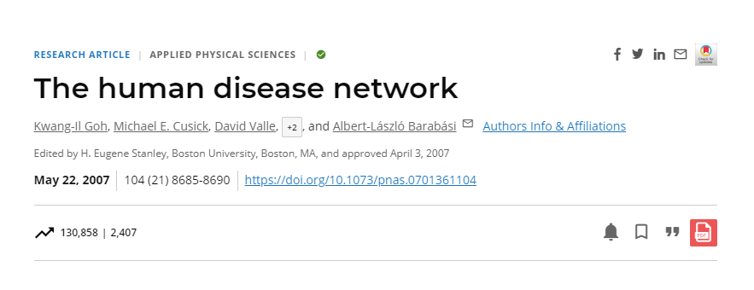
Disease network
https://pubmed.ncbi.nlm.nih.gov/17502601/

Slide 27
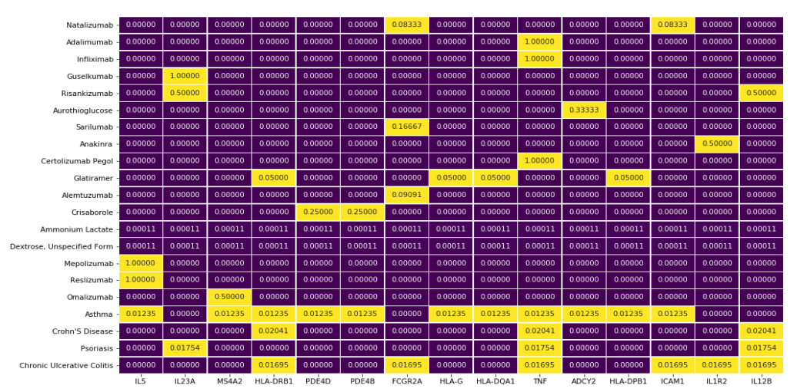
https://pubmed.ncbi.nlm.nih.gov/34014830/

Slide 28
Clustering and Bevacizumab Treatment Opportunities
Analysis: Utilized a graph-based approach to visualize clustering of diseases.
Finding: Certain clusters indicate a group of diseases treated with Bevacizumab.
Insight: Rare diseases falling into these clusters may be potential candidates for Bevacizumab treatment.

